Slide 1
Networking Devices

Slide 2
Table of Contents
Common Network Connectivity Devices
Other Specialized Devices

Slide 3
Common Network Connectivity Devices
1

Slide 4
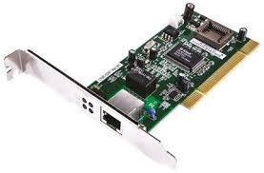
Common Network Connectivity Devices
Network Interface Controller (NIC)
A hardware that connects computers to a network
Every NIC has a unique MAC address
Notes:
A network interface controller (NIC, also known as a network interface card, network adapter, LAN adapter or physical network interface, and by similar terms) is a computer hardware component that connects a computer to a computer network.
Early network interface controllers were commonly implemented on expansion cards that plugged into a computer bus. The low cost and ubiquity of the Ethernet standard means that most newer computers have a network interface built into the motherboard.

Slide 5
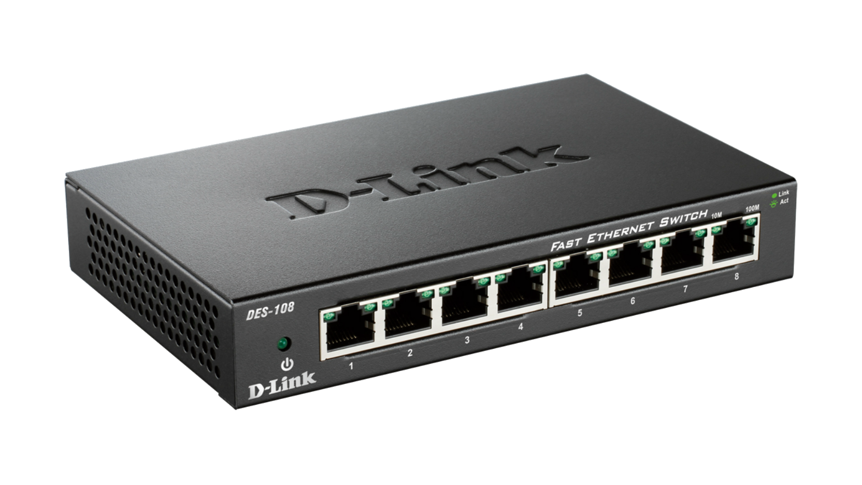
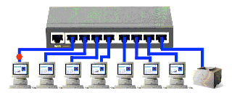
Common Network Connectivity Devices
Hub
Broadcasts data to every computer connected to it
Suitable for small LANs
Not secure because all traffic can be captured
No routing capability
Creates a collision domain
Half-duplex
Notes:
A network hub is a node that broadcasts data to every computer or Ethernet-based device connected to it. A hub is less sophisticated than a switch, the latter of which can isolate data transmissions to specific devices.
Network hubs are best suited for small, simple local area network (LAN) environments. Hubs cannot provide routing capabilities or other advanced network services. Because they operate by forwarding packets across all ports indiscriminately, network hubs are sometimes referred to as "dumb switches."
Today, hubs are considered obsolete and switches are commonly used instead. Hubs have numerous disadvantages. They are not aware of the traffic that passes through them. They create only one large collision domain. A hub typically operates in half-duplex. There is also a security issue with hubs since the traffic is forwarded to all ports (except the source port), which makes it possible to capture all traffic on a network with a network sniffer!

Slide 6
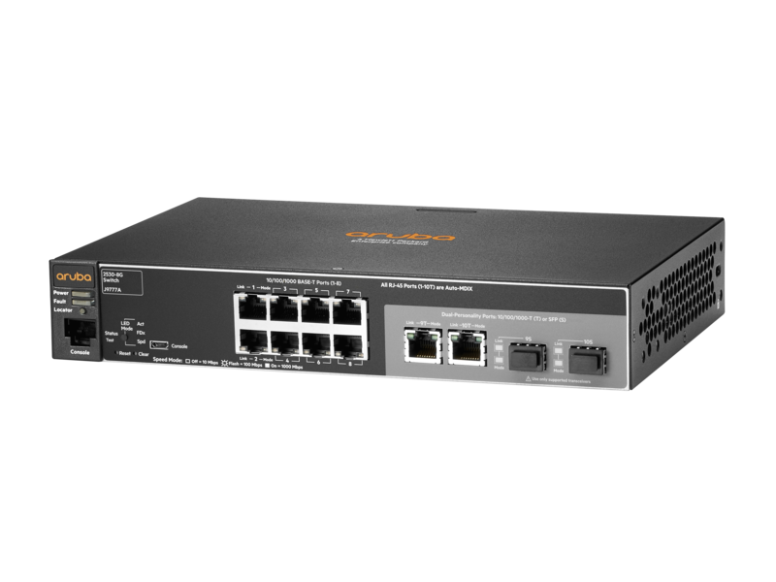
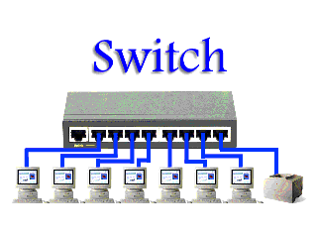
Common Network Connectivity Devices
Switch
Connects multiple hosts together (like Hub)
Works on Data Link Layer (Layer 2) (unlike Hub)
Can inspect received traffic and forwards only to recipient(s) (unlike Hub)
Each port on a Switch is a separate collision
Full-duplex (unlike Hub)
Notes:
Like hubs, a switch is used to connect multiple hosts together, but it has many advantages over a hub. A switch is an OSI Layer 2 device, which means that it can inspect received traffic and make forwarding decisions. Each port on a switch is a separate collision domain and can run in a full-duplex mode.

Slide 7
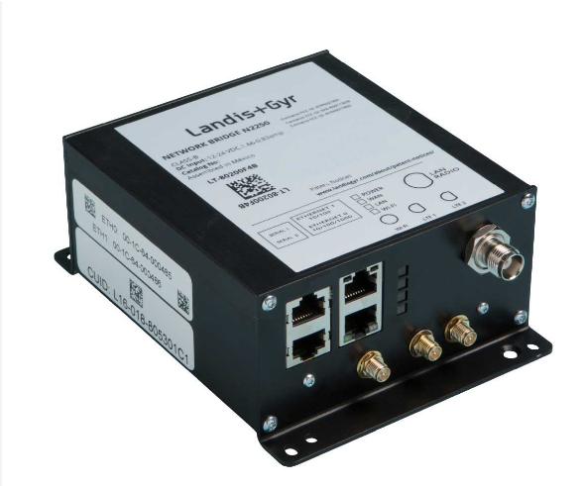
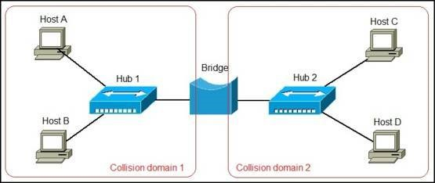
Common Network Connectivity Devices
Bridge
Divides a network into segments
Works at Data Link Layer (Layer 2)
Forwards or filters the Ethernet frames
Notes:
A network bridge is a device that divides a network into segments. Each segment represent a separate collision domain, so the number of collisions on the network is reduced. Each collision domain has its own separate bandwidth, so a bridge also improves the network performance.
A bridge works at the Data link layer (Layer 2) of the OSI model. It inspects incoming traffic and decide whether to forward it or filter it. Each incoming Ethernet frame is inspected for destination MAC address. If the bridge determines that the destination host is on another segment of the network, it forwards the frame to that segment.

Slide 8
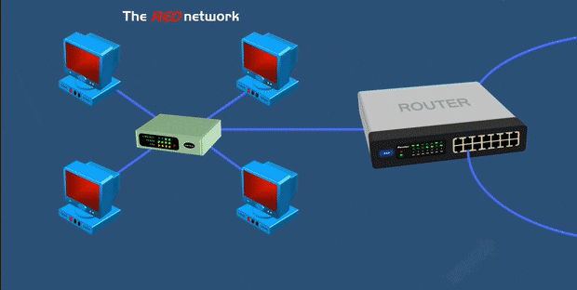
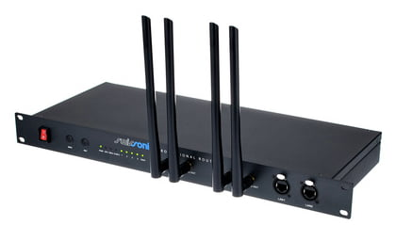
Common Network Connectivity Devices
Router
Connects multiple segments together
Uses IP addresses to make decisions about the best way to get the data to its destination
Works on Network Layer (Layer 3)
Combination of hardware and software
Notes:
A router is a network device used to connect many, sometimes disparate, network segments together, combining them into what we call an internetwork. A well-configured router can make intelligent decisions about the best way to get network data to its destination. It gathers the information it needs to make these decisions based on a network’s particular performance data. As routers use IP addresses to make forwarding decisions, they are considered Layer 3 devices.

Slide 9
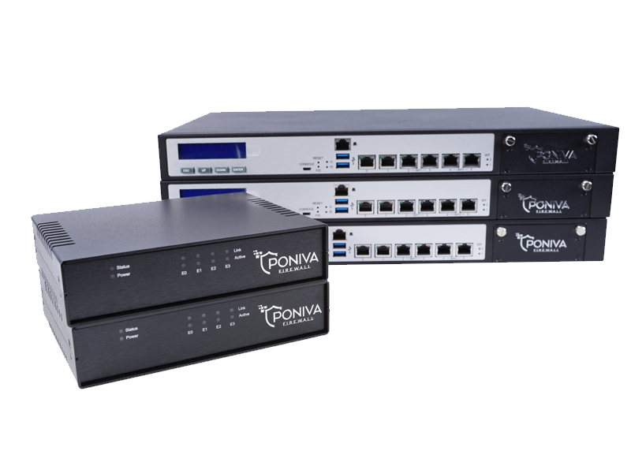
Common Network Connectivity Devices
Firewall
Prevents unauthorized access to or from a private network
Protects a network's data and resources from outside access and threats
Usually placed at the end point of a network
Either a hardware (black
box) or a software
Notes:
Firewalls prevent unauthorized access to or from a private network. Firewalls can enhance the security of computers in a LAN.
Firewalls are used to protect a network's data and resources from outside access and threats. A Firewall is used as a barrier between an internal network of an organization and another network (may be public internet or another network of the same organization).
Since the primary function of a Firewall is to protect a network's data and resources from outside threats, they are usually placed at the end point of a network.
Firewalls can either be software or hardware, though it’s best to have both. A software firewall is a program installed on each computer and regulates traffic through port numbers and applications, while a physical firewall is a piece of equipment installed between your network and gateway.

Slide 10
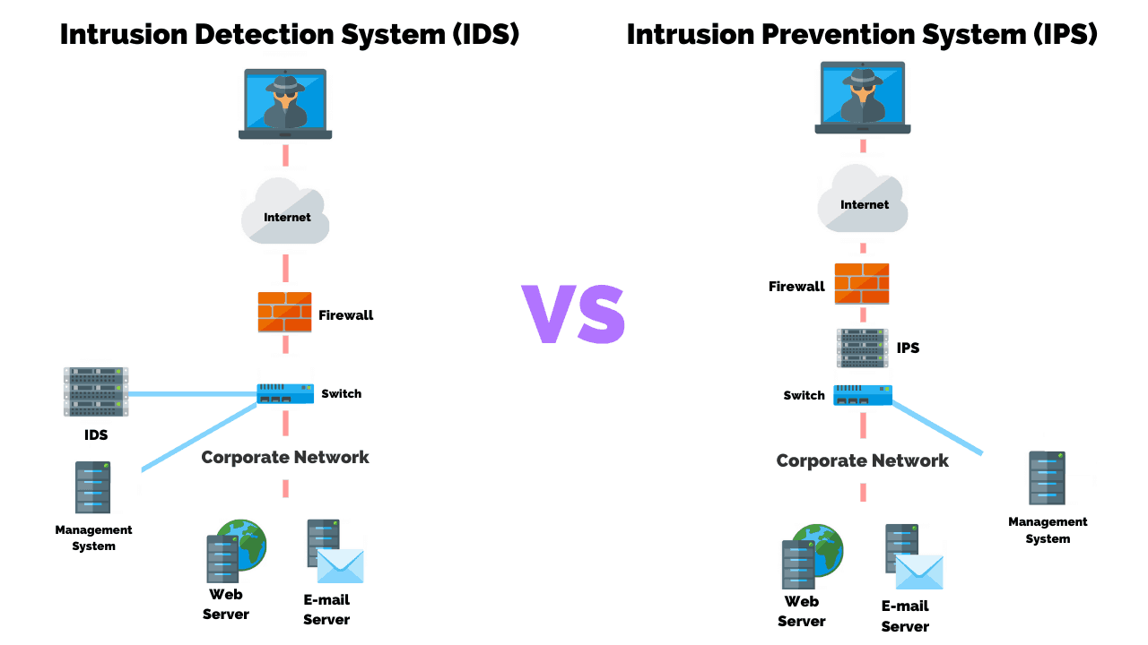
Common Network Connectivity Devices
IDS/IPS
Intrusion Detection System (IDS) monitors traffic and report malicious activities
Intrusion Prevention System (IPS) stops threats in real-time as they occur
Notes:
Intrusion detection systems (IDSs) and intrusion prevention systems (IPSs) are very important in today’s networks. They are network security appliances that monitor networks and packets for malicious activity. An IDS is considered monitor mode and just records and tells you about problems, whereas an IPS can work in real-time to stop threats as they occur. The main difference between them is that an IPS works inline to actively prevent and block intrusions that are detected based on the rules you set up. IPSs can send an alarm, create correlation rules and remediation, drop malicious packets, provide malware protection, and reset the connection of offending source hosts.

Slide 11
Other Specialized Devices
2

Slide 12
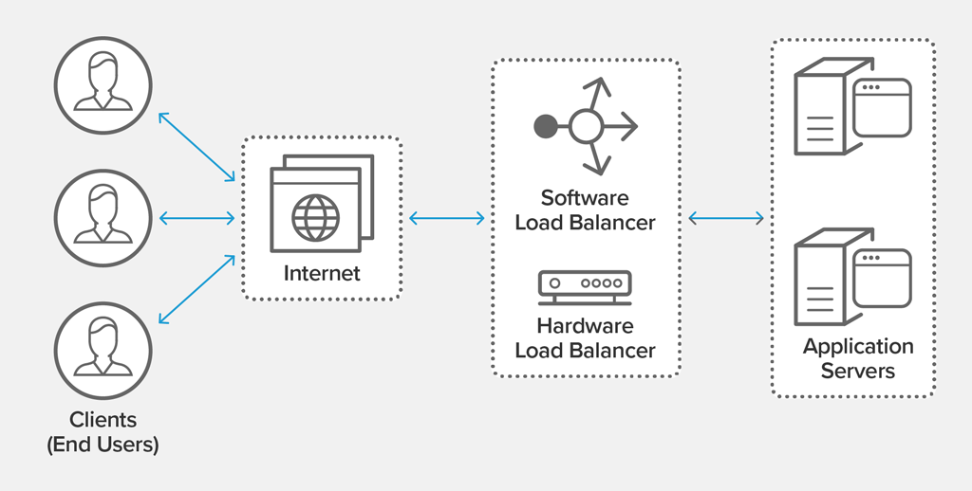
Other Specialized Devices
Load Balancer
Distributes client requests or network load efficiently across multiple servers
Ensures high availability and reliability by sending requests only to servers that are online
Provides the flexibility to
add or subtract servers
as demand dictates
Notes:
An average router just sends incoming packets to their specified, correlative IP address on the network, but a load balancer can actually send incoming packets to multiple machines hidden behind one IP address.
A load balancer acts as the “traffic cop” sitting in front of your servers and routing client requests across all servers capable of fulfilling those requests in a manner that maximizes speed and capacity utilization and ensures that no one server is overworked, which could degrade performance. If a single server goes down, the load balancer redirects traffic to the remaining online servers. When a new server is added to the server group, the load balancer automatically starts to send requests to it.
In this manner, a load balancer performs the following functions:
Distributes client requests or network load efficiently across multiple servers
Ensures high availability and reliability by sending requests only to servers that are online
Provides the flexibility to add or subtract servers as demand dictates

Slide 13
Other Specialized Devices
Domain Name Service (DNS) Server
Finds the IP addresses of hostnames
Computers use IP addresses, humans use names
Easier to remember www.clarusway.com than 13.35.253.82
There are thousands of DNS servers
Managed and controlled by The Internet Assigned Numbers Authority (IANA)
IANA is operated by the Internet Corporation for Assigned Names and Numbers (ICANN)
Notes:
The networks which are running on TCP/IP protocol suite use IP Address (IPv4 Address or IPv6 Address), as the addressing mechanism. IP address (IPv4 Address or IPv6 Address) uniquely identifies a TCP/IP device in the network. However, it is difficult for the humans to remember IP Addresses for all the computers they want to communicate. Think about difficulty in remembering the IP Addresses of 1000s of web sites we use, if we do not have the option to use their names. Humans prefer to use names instead of IP Addresses. Hence we need a system to map human readable names to corresponding IP Addresses.
The global public Domain Name System (DNS) has a distributed architecture, serving from multiple DNS servers in multiple locations. This helps in load balancing (decreasing the workload on DNS servers) and redundancy (prevents single point of failure).
The Internet Assigned Numbers Authority (IANA) manages and controls the public Internet DNS infrastructure. The Internet Assigned Numbers Authority (IANA) is operated by the Internet Corporation for Assigned Names and Numbers (ICANN).

Slide 14
Other Specialized Devices
Domain Name Service (DNS) Server
.com A commercial organization
.edu An educational establishment, such as a university
.gov A branch of the U.S. government
.int An international organization, such as NATO or the United Nations
.mil A branch of the U.S. military
.net A network organization
.org A nonprofit organization
Some DNS names end with country name like:
.jp (Japan) .ca (Canada) .uk (Great Britain)
Notes:
We said that the DNS has a hierarchical naming system.
On the Internet, domains are arranged in a hierarchical tree structure. The following list includes some of the top-level domains currently in use:
.com A commercial organization. Most companies end up as part of this domain.
.edu An educational establishment, such as a university.
.gov A branch of the U.S. government.
.int An international organization, such as NATO or the United Nations.
.mil A branch of the U.S. military.
.net A network organization.
.org A nonprofit organization.
In other parts of the world, the final part of a domain name represents the country in which the server is located (.ca for Canada, .jp for Japan, .uk for Great Britain, and .ru for Russia, for example). Over 130 countries are represented on the Internet.

Slide 15
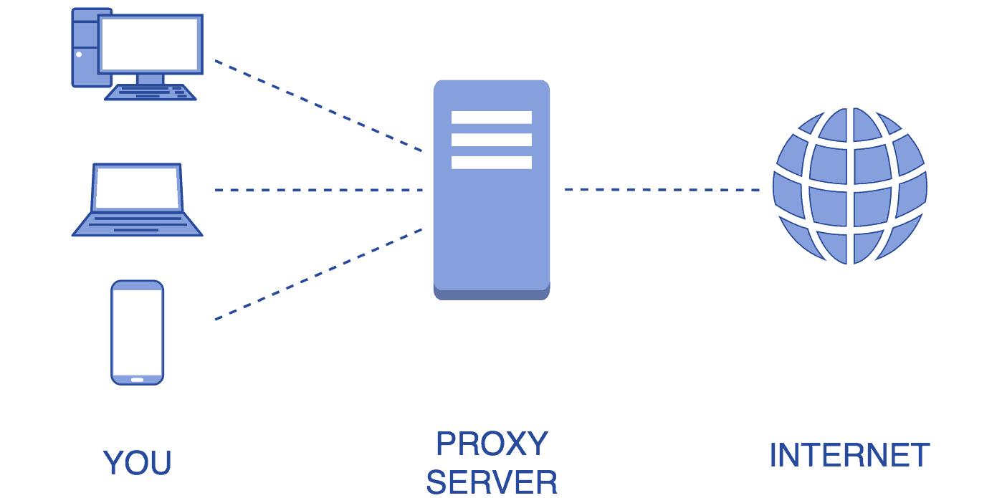
Other Specialized Devices
Proxy Server
Acts as a gateway between you and the internet
Acts as a firewall and web filter
Provides shared network connections
Caches data to speed up common requests
Provides privacy
Notes:
Proxy sunucusu, sizinle internet arasında bir ağ geçidi görevi görür. Son kullanıcıları göz attıkları web sitelerinden ayıran bir aracı sunucudur. Proxy sunucuları, kullanım durumunuza, ihtiyaçlarınıza veya şirket politikanıza bağlı olarak değişen düzeylerde işlevsellik, güvenlik ve gizlilik sağlar.Bir proxy sunucusu kullanıyorsanız, internet trafiği, talep ettiğiniz adrese giderken proxy sunucusu üzerinden akar. İstek daha sonra aynı proxy sunucusu üzerinden geri gelir (bu kuralın istisnaları vardır) ve ardından proxy sunucusu web sitesinden alınan verileri size iletir.Tüm yaptığı buysa, neden bir proxy sunucusuyla uğraşasınız ki? Neden doğrudan web sitesine gidip geri dönmüyorsunuz?Modern proxy sunucuları, tümü veri güvenliği ve ağ performansı adına web isteklerini iletmekten çok daha fazlasını yapar. Proxy sunucuları bir güvenlik duvarı ve web filtresi görevi görür, paylaşılan ağ bağlantıları sağlar ve yaygın istekleri hızlandırmak için verileri önbelleğe alır. İyi bir proxy sunucusu, kullanıcıları ve dahili ağı vahşi internette yaşayan kötü şeylerden korur. Son olarak, proxy sunucuları yüksek düzeyde gizlilik sağlayabilir.Bir Proxy Sunucusu Nasıl Çalışır?İnternetteki her bilgisayarın benzersiz bir İnternet Protokolü (IP) Adresine sahip olması gerekir.Bir proxy sunucusu, temel olarak, bilgisayarınızın bildiği kendi IP adresine sahip internetteki bir bilgisayardır. Bir web isteği gönderdiğinizde, isteğiniz önce proxy sunucusuna gider. Proxy sunucusu daha sonra sizin adınıza web talebinizi yapar, web sunucusundan yanıtı toplar ve sayfayı tarayıcınızda görebilmeniz için size web sayfası verilerini iletir.Proxy sunucusu web isteklerinizi ilettiğinde, gönderdiğiniz verilerde değişiklik yapabilir ve yine de size görmeyi beklediğiniz bilgileri sağlayabilir. Bir proxy sunucusu IP adresinizi değiştirebilir, bu nedenle web sunucusu dünyanın neresinde olduğunuzu tam olarak bilemez. Verilerinizi şifreleyebilir, böylece verileriniz aktarım sırasında okunamaz. Ve son olarak, bir proxy sunucusu, IP adresine bağlı olarak belirli web sayfalarına erişimi engelleyebilir.
A proxy server acts as a gateway between you and the internet. It’s an intermediary server separating end users from the websites they browse. Proxy servers provide varying levels of functionality, security, and privacy depending on your use case, needs, or company policy.
If you’re using a proxy server, internet traffic flows through the proxy server on its way to the address you requested. The request then comes back through that same proxy server (there are exceptions to this rule), and then the proxy server forwards the data received from the website to you.
If that’s all it does, why bother with a proxy server? Why not just go straight from to the website and back?
Modern proxy servers do much more than forwarding web requests, all in the name of data security and network performance. Proxy servers act as a firewall and web filter, provide shared network connections, and cache data to speed up common requests. A good proxy server keeps users and the internal network protected from the bad stuff that lives out in the wild internet. Lastly, proxy servers can provide a high level of privacy.
How Does a Proxy Server Operate?
Every computer on the internet needs to have a unique Internet Protocol (IP) Address.
A proxy server is basically a computer on the internet with its own IP address that your computer knows. When you send a web request, your request goes to the proxy server first. The proxy server then makes your web request on your behalf, collects the response from the web server, and forwards you the web page data so you can see the page in your browser.
When the proxy server forwards your web requests, it can make changes to the data you send and still get you the information that you expect to see. A proxy server can change your IP address, so the web server doesn’t know exactly where you are in the world. It can encrypt your data, so your data is unreadable in transit. And lastly, a proxy server can block access to certain web pages, based on IP address.

Slide 16
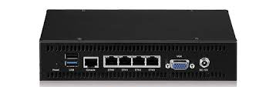
Other Specialized Devices
Encryption Devices
Allows you to create secure connections over insecure channels
Sometimes called encryption gateway
Notes:
Network encryptors secure data travelling across today’s highly distributed computer network topologies. To protect data in motion – in real-time – requires a crypto management with extremely high performance and strong algorithms in order to avoid latency and synchronization problems.
Encryption allows you to create secure connections over insecure channels. Encrypting your network traffic provides two useful guarantees: privacy and authentication.
There are dedicated appliances that can perform encryption as well. The advantage of using these devices is that they normally provide more choice of encryption methods and stronger encryption options. They also offload the process from other devices like routers and servers, which is a good thing since the encryption/decryption process is very processor-intensive and interferes with other functions that those routers and servers might be performing.

Slide 17
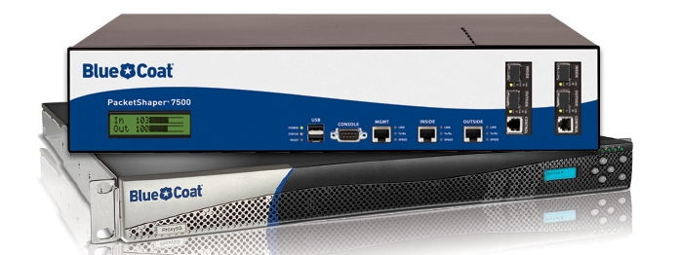
Other Specialized Devices
Packet Shaping (Traffic Shaping)
Traffic shaping (or packet shaping) is a congestion management method that regulates network data transfer by delaying the flow of less important or less desired packets.
Used to optimize network performance by prioritizing certain traffic flows and ensuring the traffic rate doesn't exceed the bandwidth limit.
Notes:
Traffic shaping, also known as packet shaping, is a congestion management method that regulates network data transfer by delaying the flow of less important or less desired packets. It is used to optimize network performance by prioritizing certain traffic flows and ensuring the traffic rate doesn't exceed the bandwidth limit.
Regulating the flow of packets into a network is known as data transfer throttling. Regulation of the flow of packets out of a network is known as rate limiting.
In addition to bandwidth, three major factors affect the quality of a network: latency, jitter and loss.
Traffic shaping attempts to prevent delay, jitter and loss by controlling the burst size and using a leaky bucket algorithm to smooth the output rate over at least eight time intervals. If traffic is arriving at a rate lower than the configured rate, then it will be forwarded normally. If traffic arrives faster than the configured rate, then it will be delayed and held in a buffer until it can be sent without going over the limit.

Slide 18
Other Specialized Devices
Packet Shaping (Traffic Shaping)
Common uses of traffic shaping include:
Time-sensitive data may be given priority over traffic that can be delayed briefly
In a corporate environment, business-related traffic may be given priority over other traffic
A large ISP may shape traffic based on customer priority
An ISP may limit maximum bandwidth consumption for certain applications to reduce costs and create the capacity to take on additional subscribers
Notes:
Traffic shaping, also known as packet shaping, is a congestion management method that regulates network data transfer by delaying the flow of less important or less desired packets. It is used to optimize network performance by prioritizing certain traffic flows and ensuring the traffic rate doesn't exceed the bandwidth limit.
Regulating the flow of packets into a network is known as data transfer throttling. Regulation of the flow of packets out of a network is known as rate limiting.
In addition to bandwidth, three major factors affect the quality of a network: latency, jitter and loss.
Traffic shaping attempts to prevent delay, jitter and loss by controlling the burst size and using a leaky bucket algorithm to smooth the output rate over at least eight time intervals. If traffic is arriving at a rate lower than the configured rate, then it will be forwarded normally. If traffic arrives faster than the configured rate, then it will be delayed and held in a buffer until it can be sent without going over the limit.

Slide 19
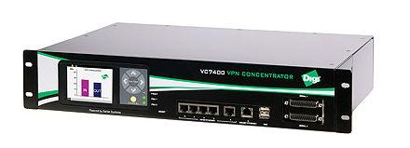
Other Specialized Devices
VPN Concentrator
Provides secure creation of VPN connections
A type of router device
It can:
Establish and configure tunnels
Authenticate users
Assign tunnel/IP addresses to users
Encrypt and decrypt data
Ensure end-to-end delivery of data
Notes:
A VPN concentrator is a type of networking device that provides secure creation of VPN connections and delivery of messages between VPN nodes.
It is a type of router device, built specifically for creating and managing VPN communication infrastructures.
A VPN concentrator primarily adds the capabilities of a VPN router by adding advanced data and network security to the communications. It has the ability to create and manage a large quantity of VPN tunnels.
A VPN concentrator is typically used for creating site-to-site VPN architectures. It can:
Establish and configure tunnels
Authenticate users
Assign tunnel/IP addresses to users
Encrypt and decrypt data
Ensure end-to-end delivery of data

Slide 20

THANKS!
Any questions?

